Slide 1

LGBTQ+ ADOPTION
By Bernice, Esther, Kimberly, Julissa, Madison, Melissa, Osvaldo, Ramiro & Sherwang

Slide 2
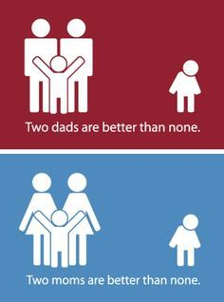
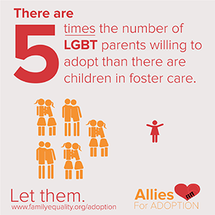
Public Problem
There is a stigma against LGBT couples adopting, and many policies nationwide that states and adoption agencies to turn away LGBT couples

Slide 3
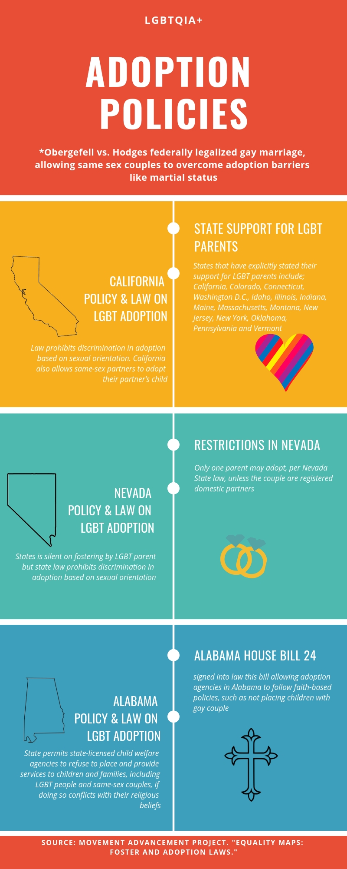
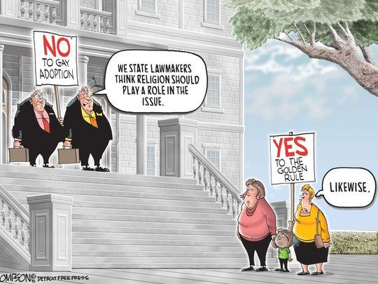
Causes of Problem
Federal law does not protect against discrimination of LGBT couples, negative stereotypes against LGBT parents and their influence on sexual orientation

Slide 4
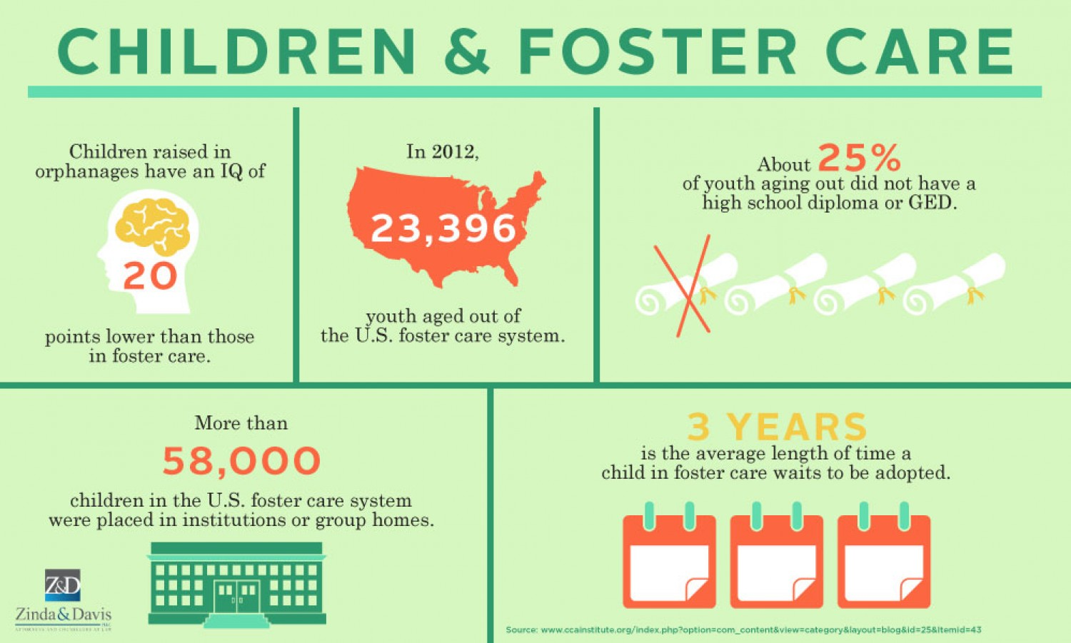
Effects of Problem
Leaves thousands of children in the foster care system, and allowing for the stigma of LGBT parents to live on

Slide 5
Federal & State Solutions of Problem
Federal: Amend the Equal Protection Clause that allows for LGBT couples to have all the same rights as a hetero normative couple. Regardless of sexual orientation added to constitution as a protection. Making it illegal for any state or government affiliated institution to discriminate against LGBT individuals and couples.
State:
Under law, states are not able to discriminate any person based on race, religion sex or sexual orientation.
Requires foster care homes to meet a certain number of LGBT families adoptions per year
If quota is not met they are required to submit a 6 month report to the state explaining their efforts to recruit LGBT communities to adopt. Meet a quota of 15

Slide 6
Local & Legal Solutions of Problem
Local
Propose a bill to allocate money to educating communities about growing social issues such as LGBT exclusion from adopting and rights heteronormative couples have.
LGBT center for communities
Attempt to mobilize communities to talk about the benefits of children being adopted by couples that are LGBT
Courts: Possible lawsuits calling for equality with in all couples that could support the push for equality in these LGBT communities.

Slide 7
14th Amendment: Section 1.
All persons born or naturalized in the United States, and subject to the jurisdiction thereof, are citizens of the United States and of the state wherein they reside. No state shall make or enforce any law which shall abridge the privileges or immunities of citizens of the United States; nor shall any state deprive any person of life, liberty, or property, without due process of law; nor deny to any person within its jurisdiction the equal protection of the laws.

Slide 8
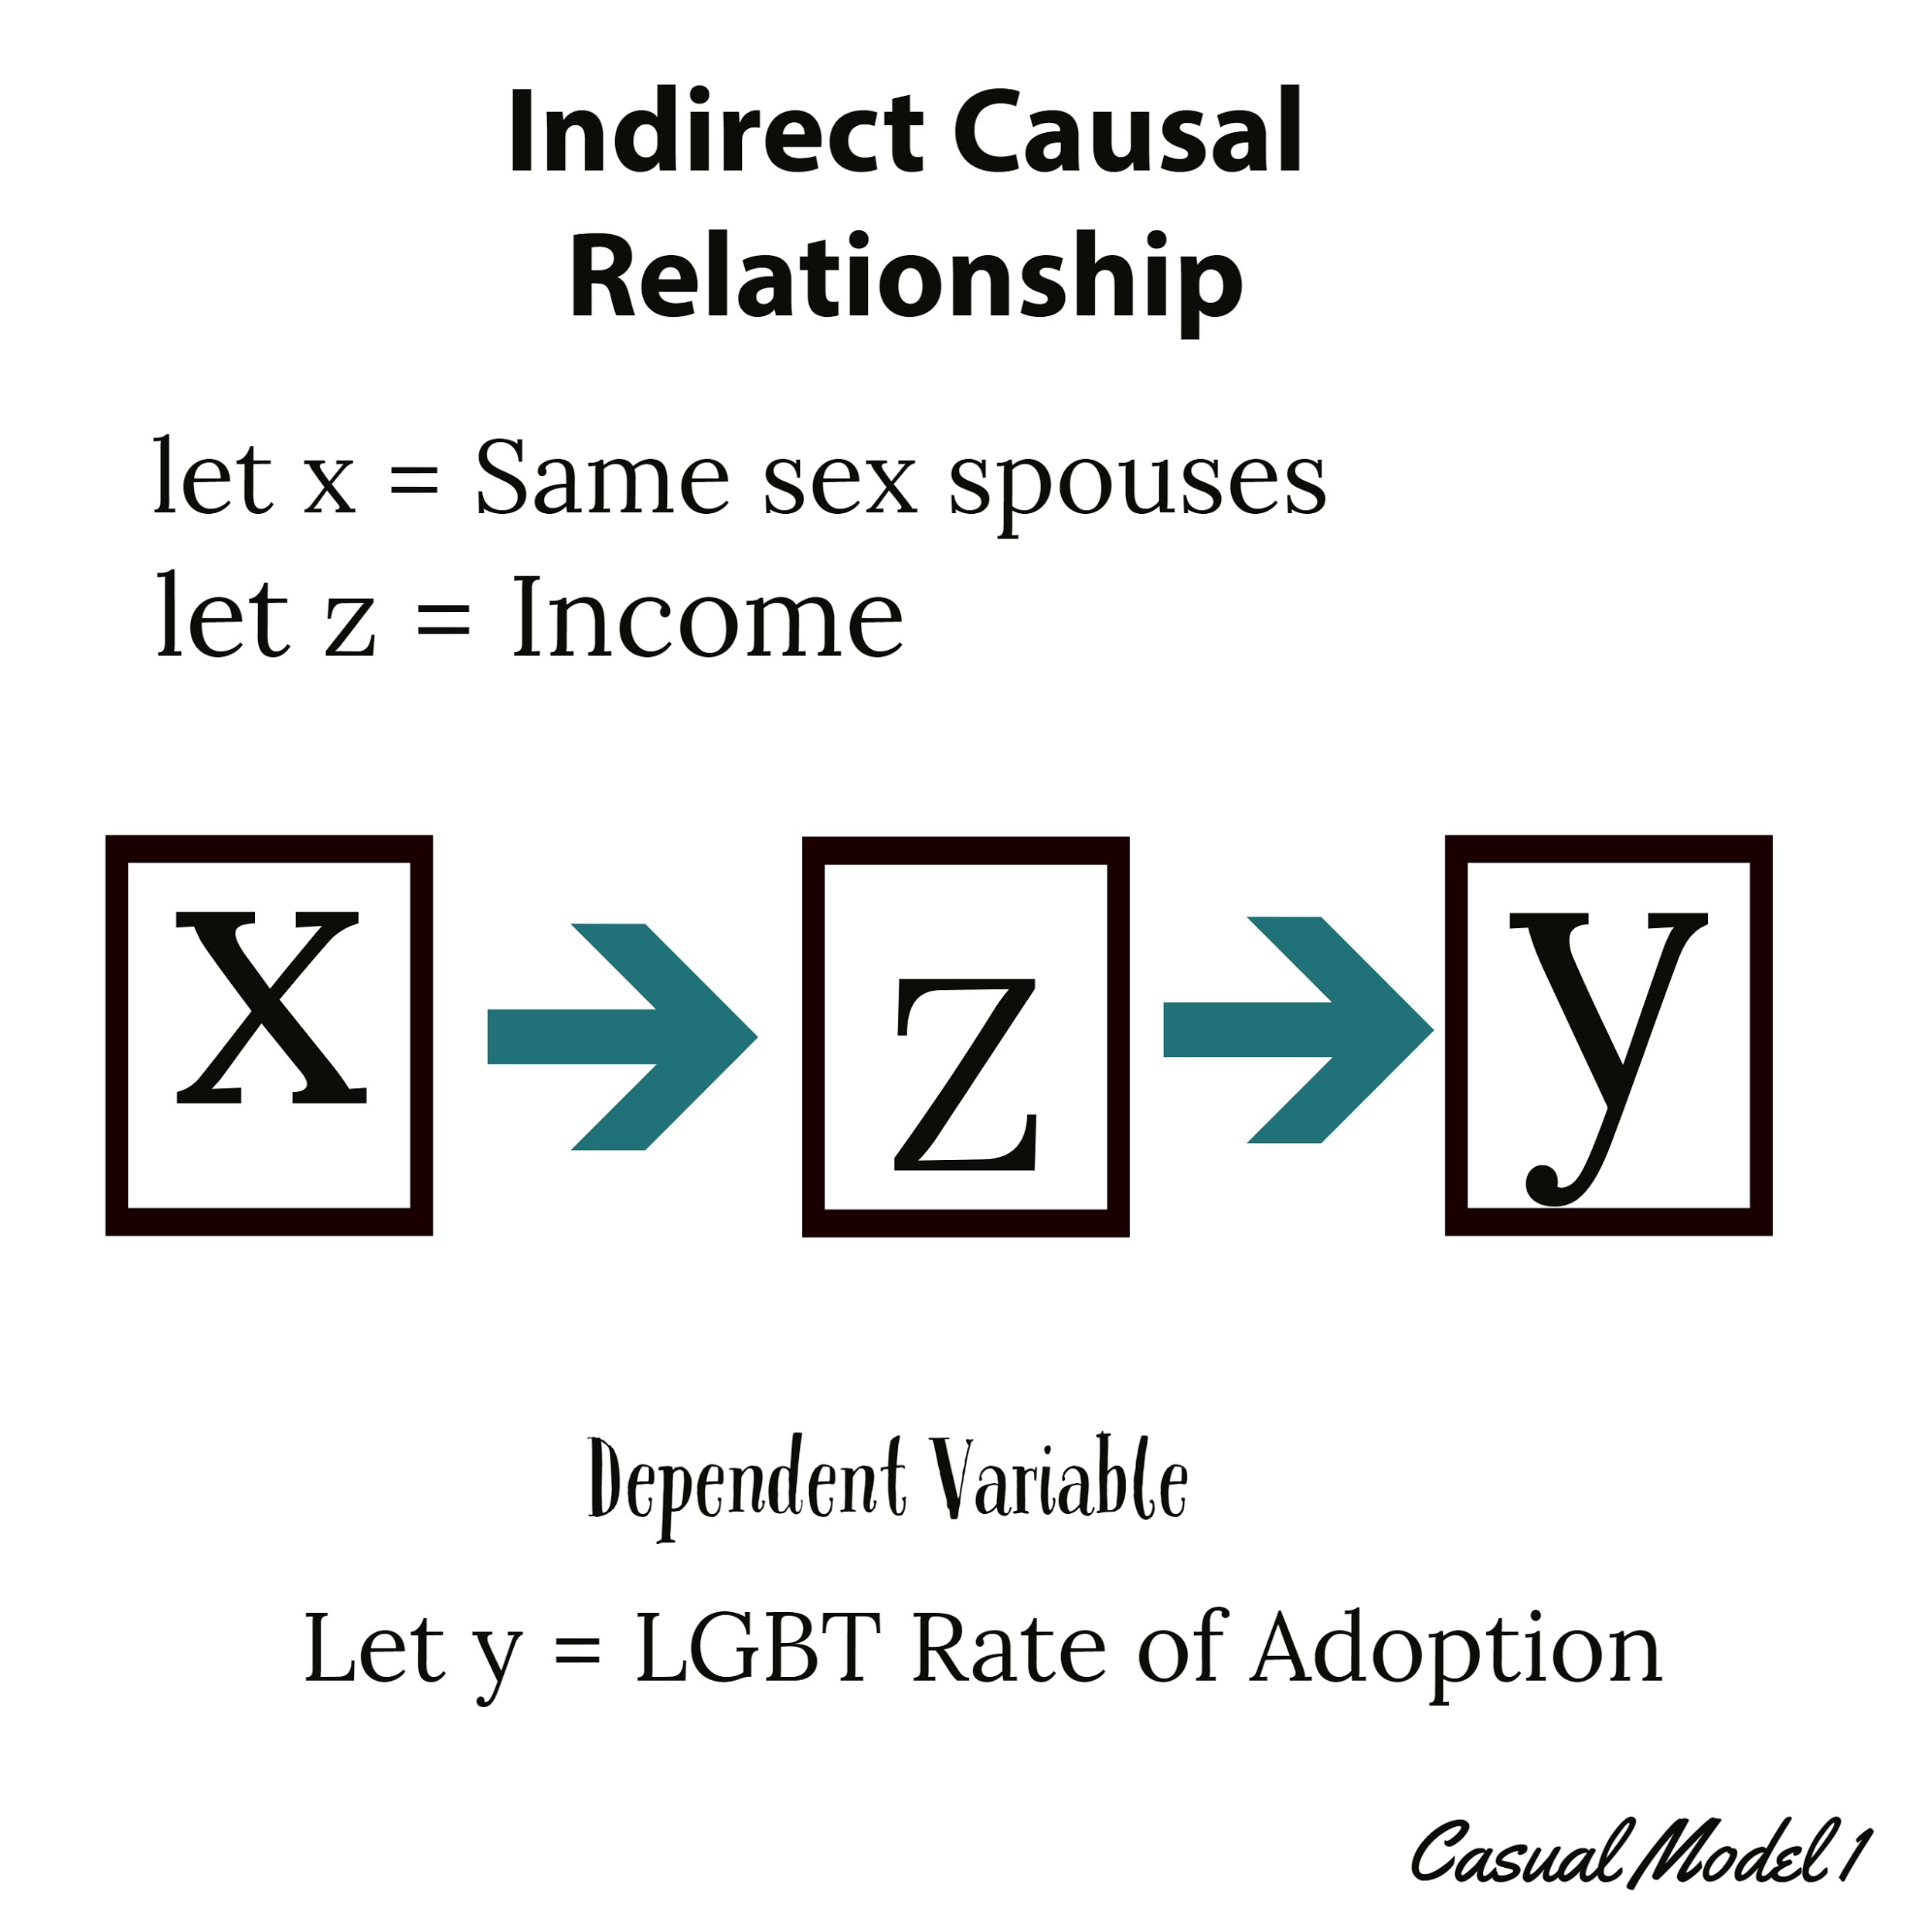
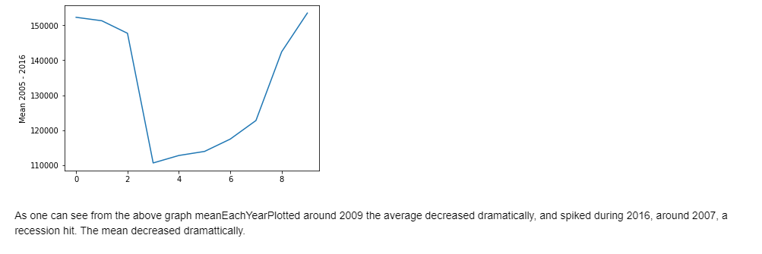
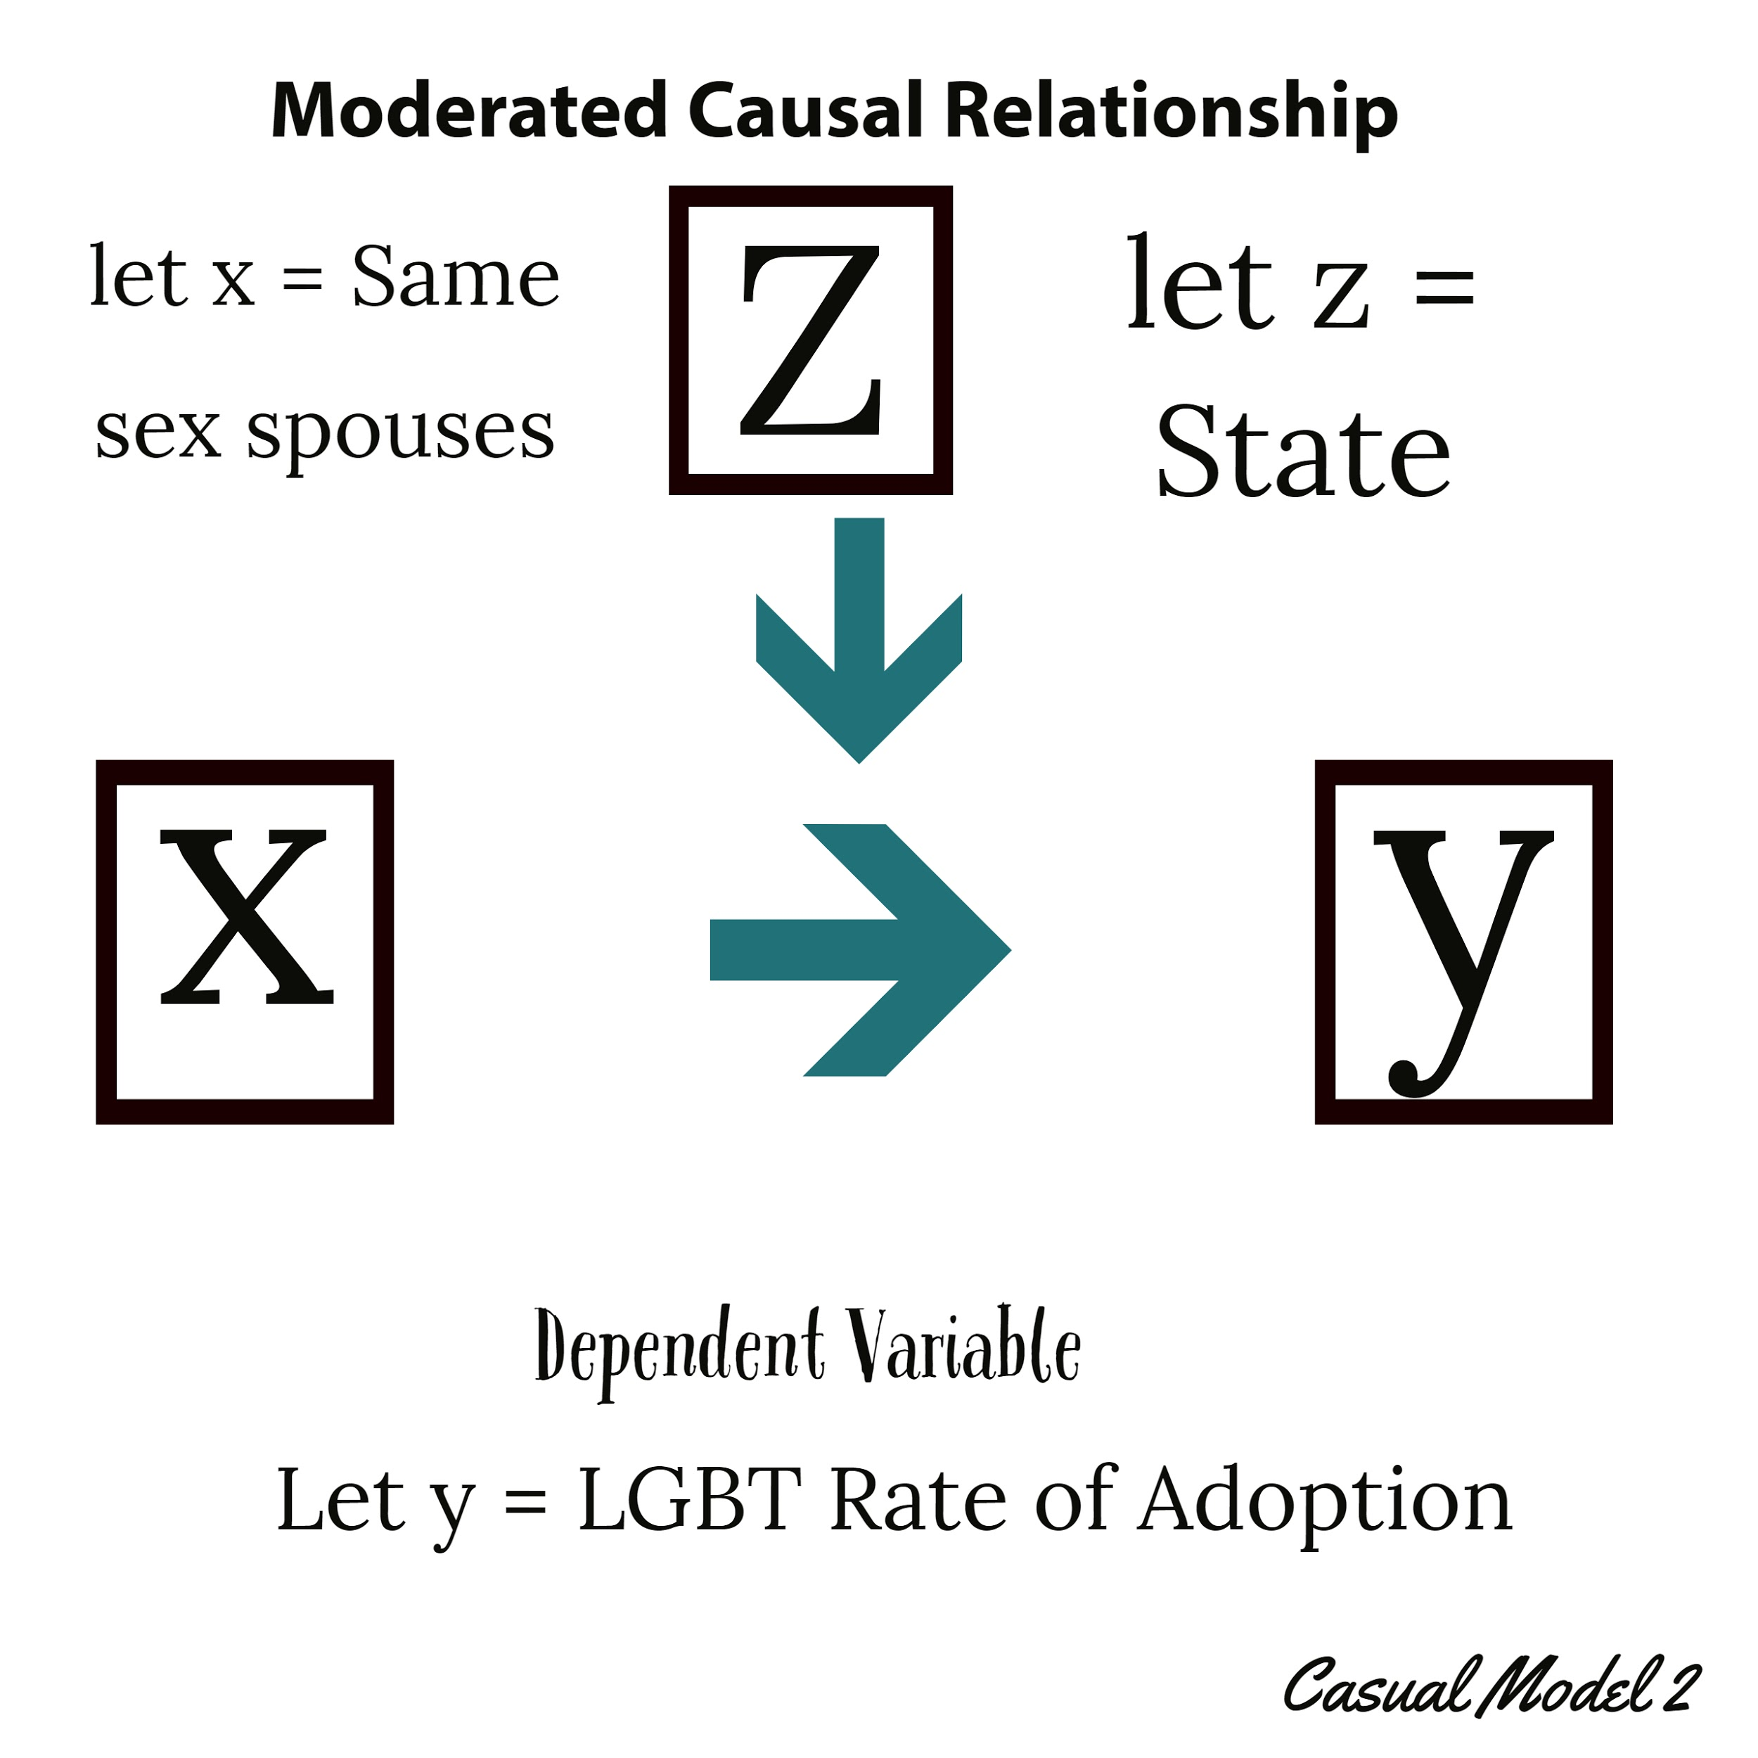
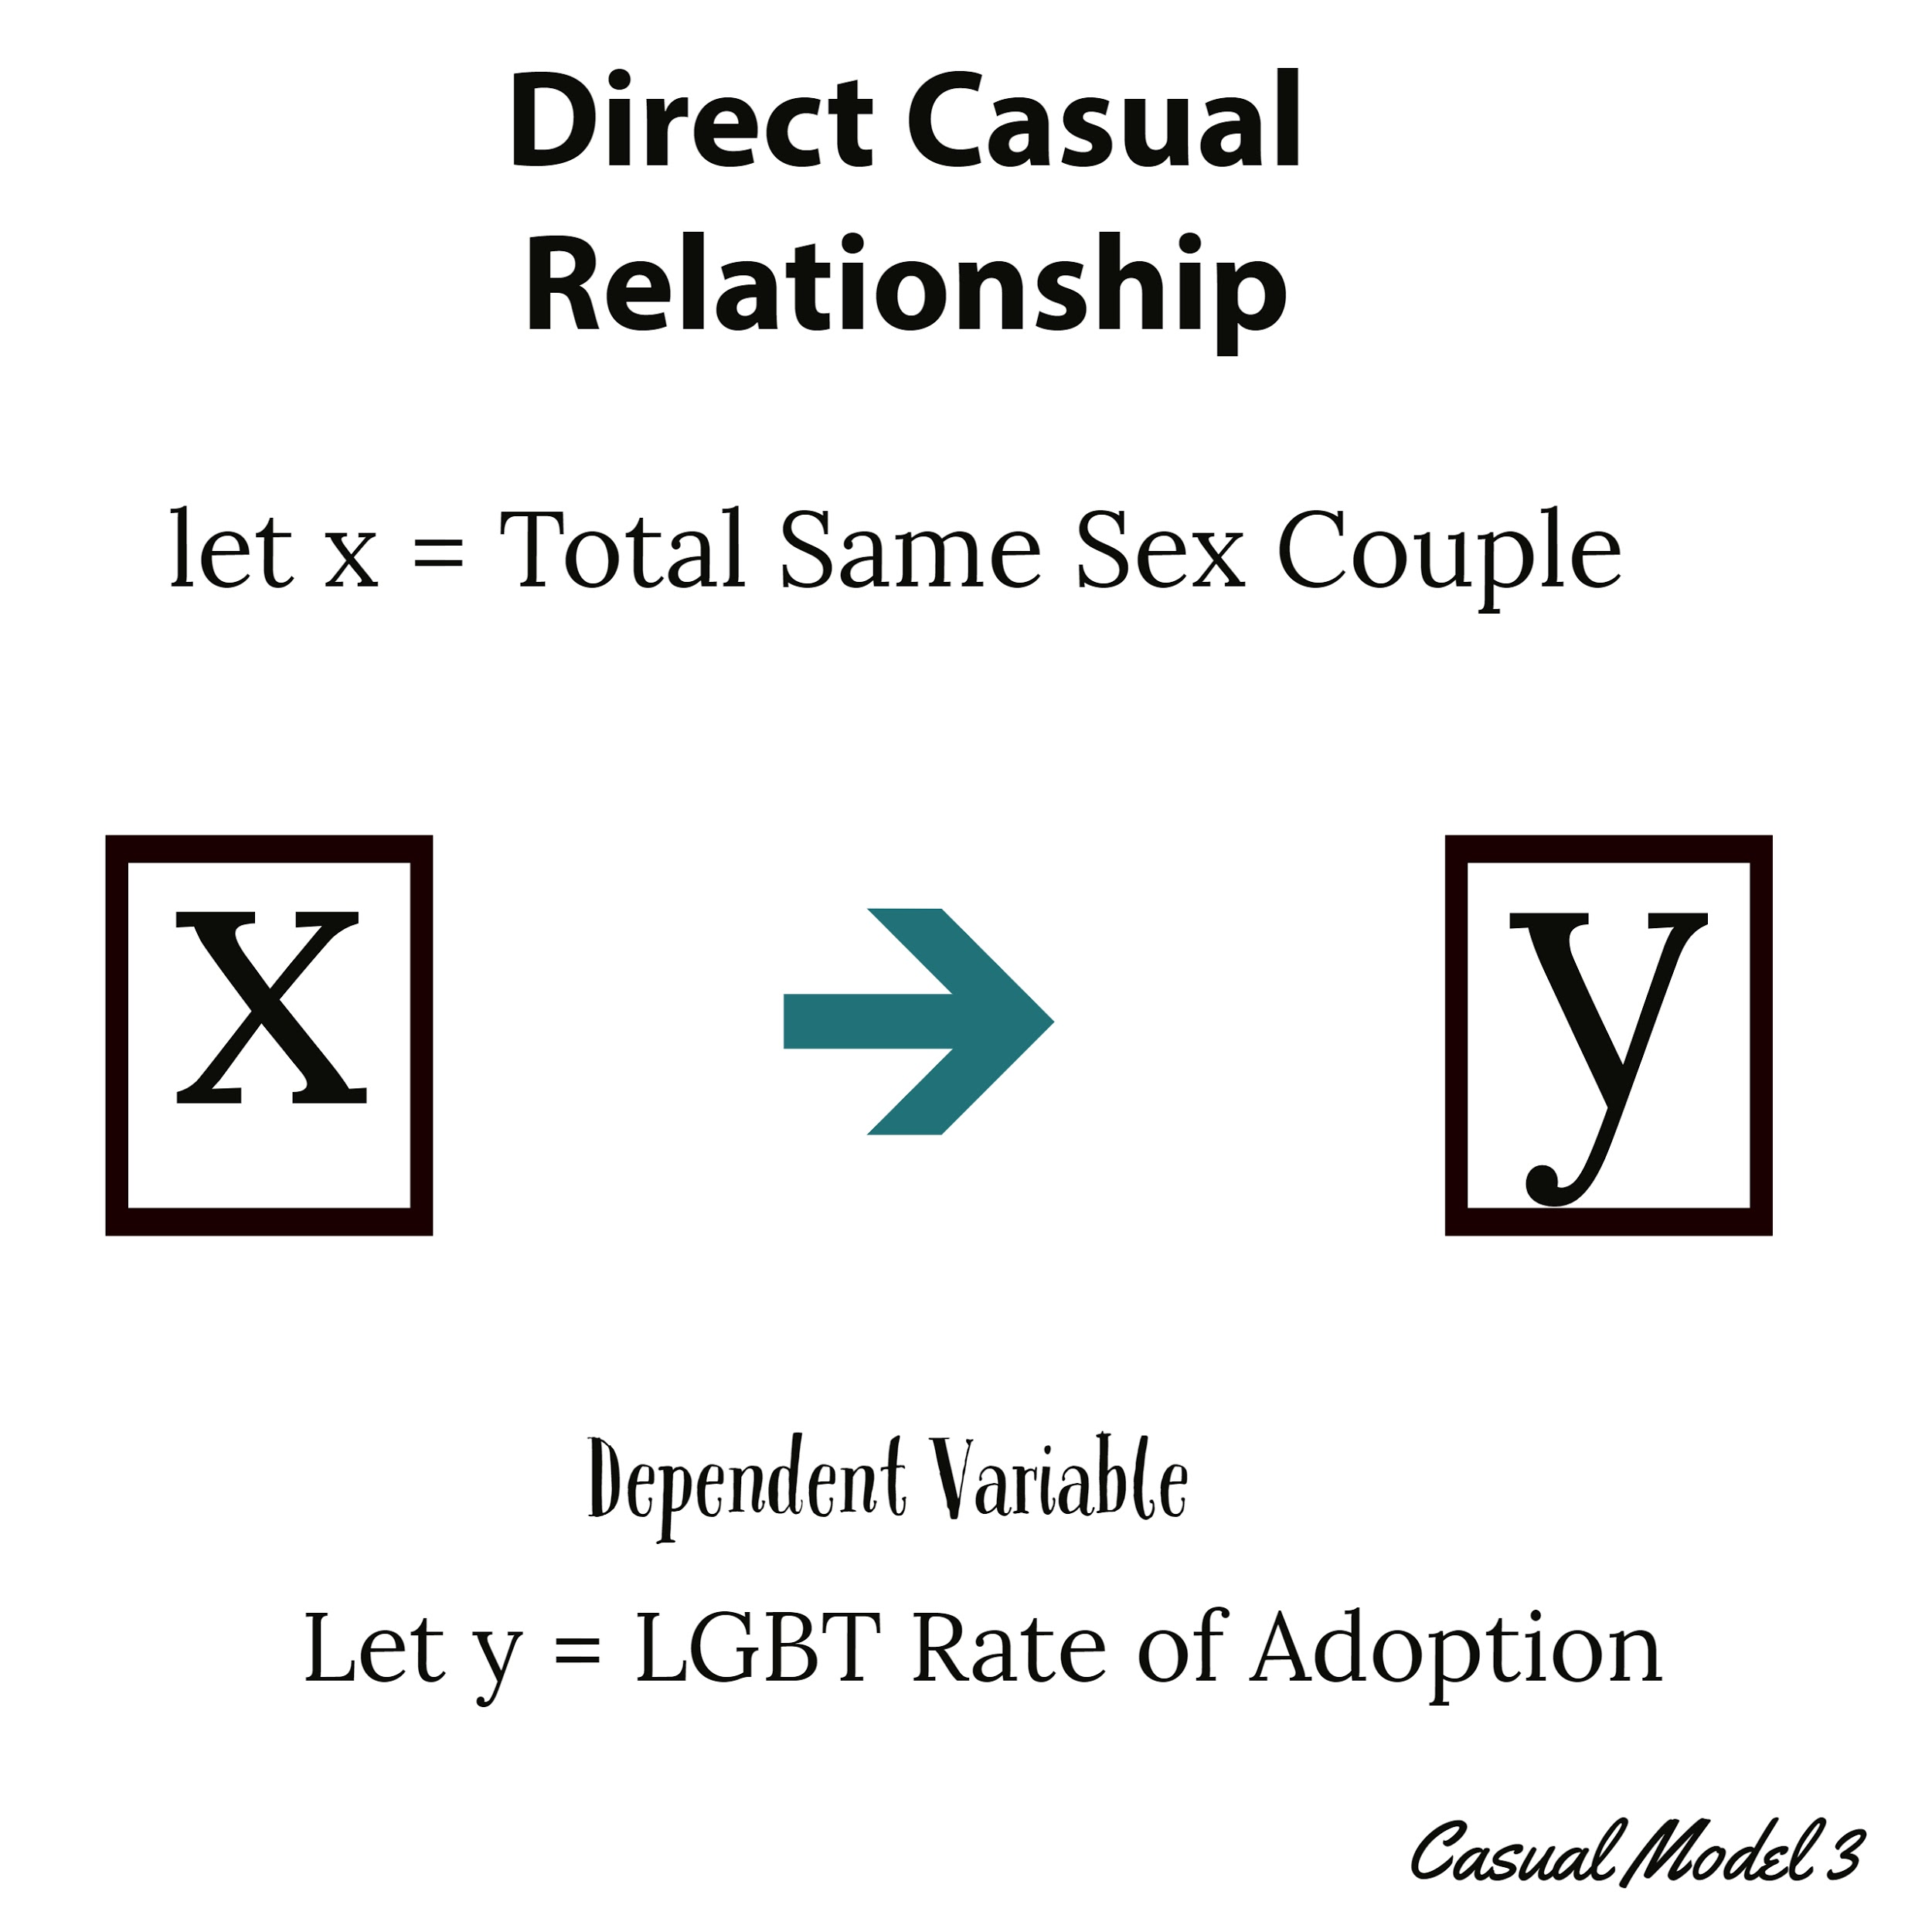
Data Analyst’s Highlights
Casual Models
Findings:
(1) Having a spouse increases the chance of adoption. Income may be the hidden factor that causes this relationship since both partners may be bringing home income. [Income is the mediating variable].
(2) Same sex spouses adopt at a higher rate. The state decides whether to allow marriage before 2015.
Income Same Sex Couple
As one can see from the graph above in 2007 the mean income began to decline. This is pre recession. The adoption rate would be relatively low in 2007. Income tends to be very high, this may be due to the state they reside at.

Slide 9
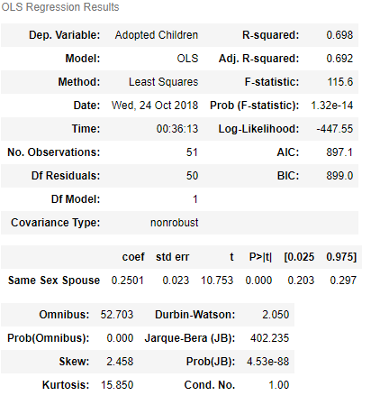
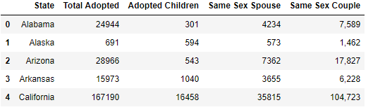
Data Analyst’s Highlights
Analysis of Year 2007
Findings:
Adopted Children is the independent variable, Same Sex Spouses are more likely to adopt since being a spouse means you live in state that allows same sex marriage. Total adopted includes non same sex couples, this Casual models show that depending on the state an lgbtq person resides affects the adoption rate. In order to be considered a spouse the laws must allow it. Summary Statistics of same sex spouse (independent variable 2, showed california had the most same sex spouses, alaska had the lowest, this correlated to california having high adoption rate and alaska low adoption rate.
Regression of spouse (independent) | adopted children (dependent)
Approx = 69.8 variability

Slide 10
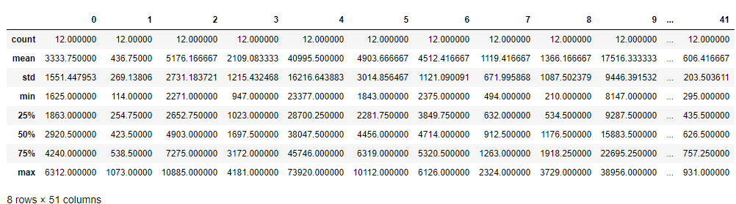
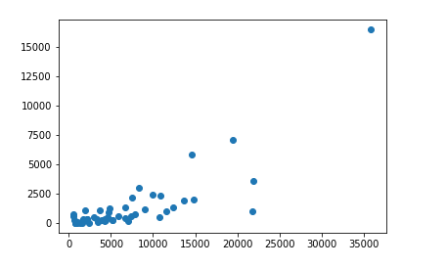
Data Analyst’s Highlights
Same_sex_spouses | Each state
Same Sex Spouse | Adopted Children Scatter Plot
Findings: California (4) has the highest adoption rate by LGBT, because it has the highest LGBT population , policies that support and protect LGBTQ. Max 73920
(Scatter Plot) The more same sex spouses the more adopted children.
For more details: http://data-analyst-poli127.tk/

Slide 11
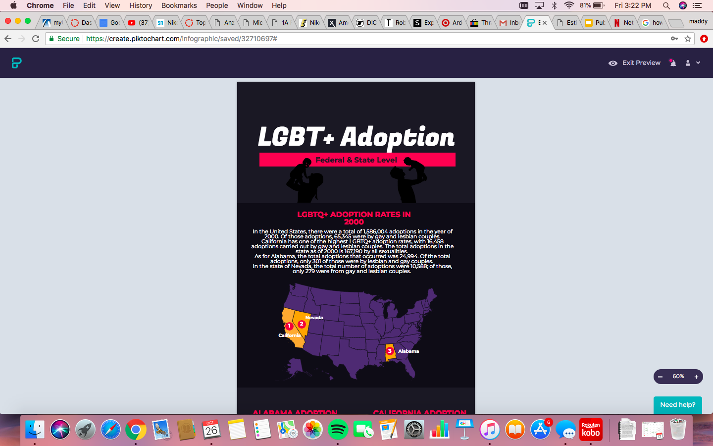
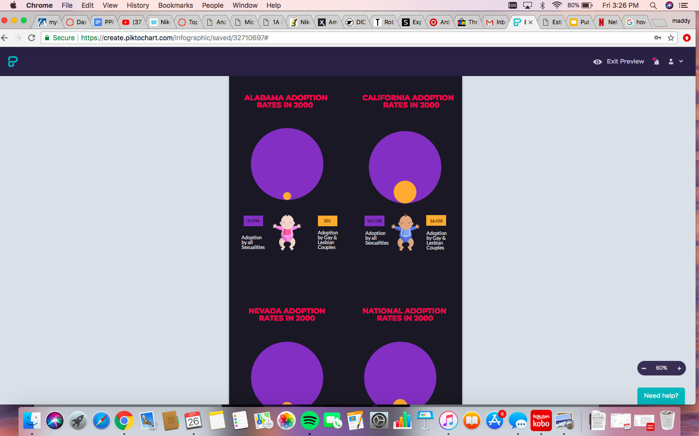
Statistics Infographic

Slide 12
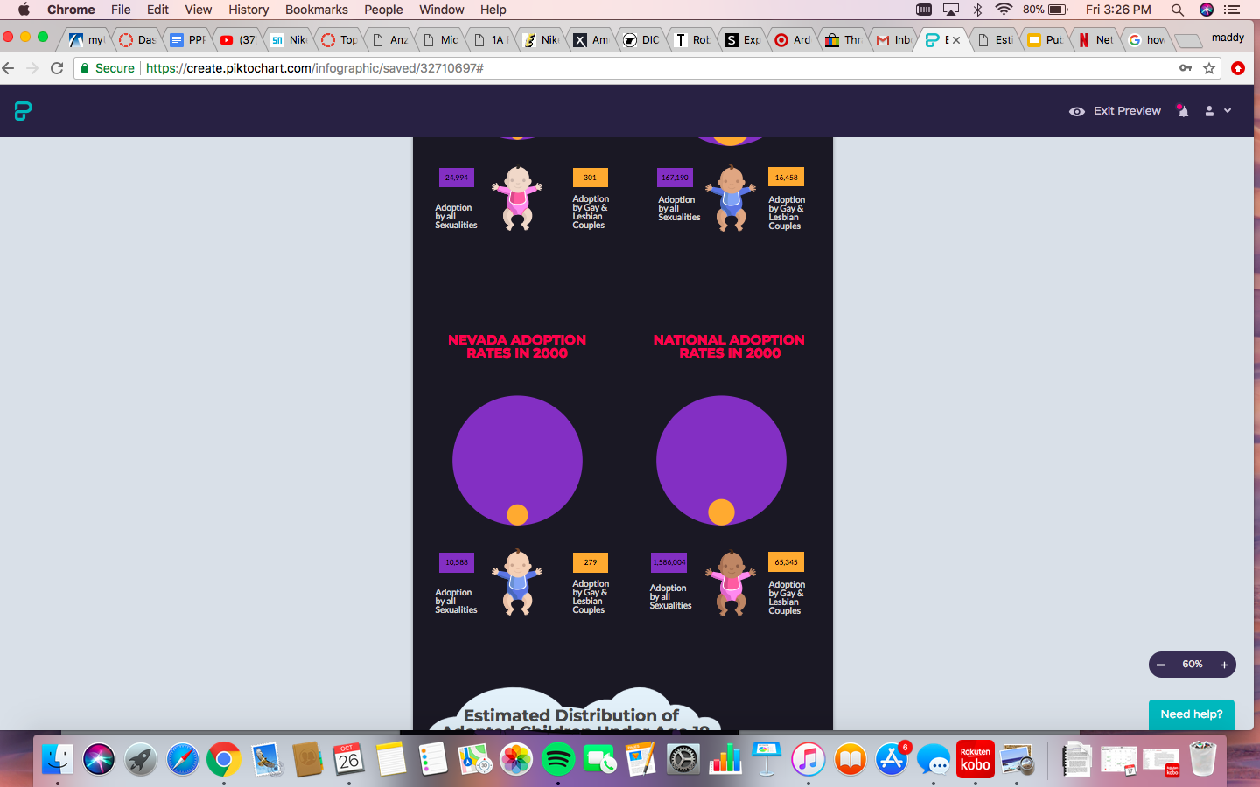
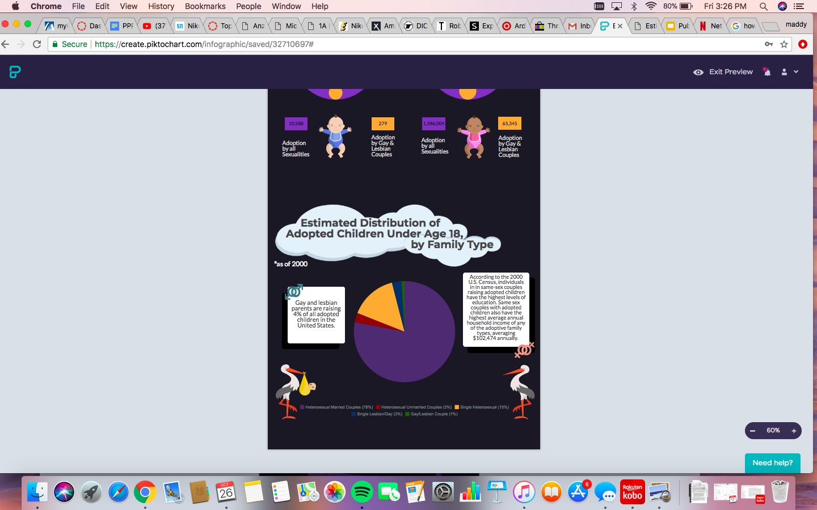
Statistics Continued

Slide 13
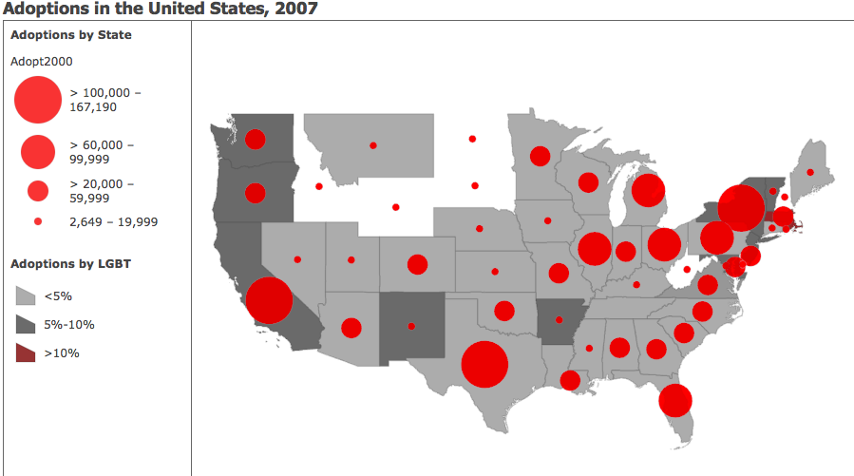

GIS Analyst’s Highlights
Findings:
States with the highest numbers in adoptions include California, Texas, Massachusetts and New York
States where children are more likely to be living with a same-sex couple include Massachusetts (16.4%), California (9.4) and New Mexico (9%)
LGBT parents are raising less than 5% of all adoptive children in the United States
Note: States that are not color coded had not data on adoptions by LGBT couples.

Slide 14
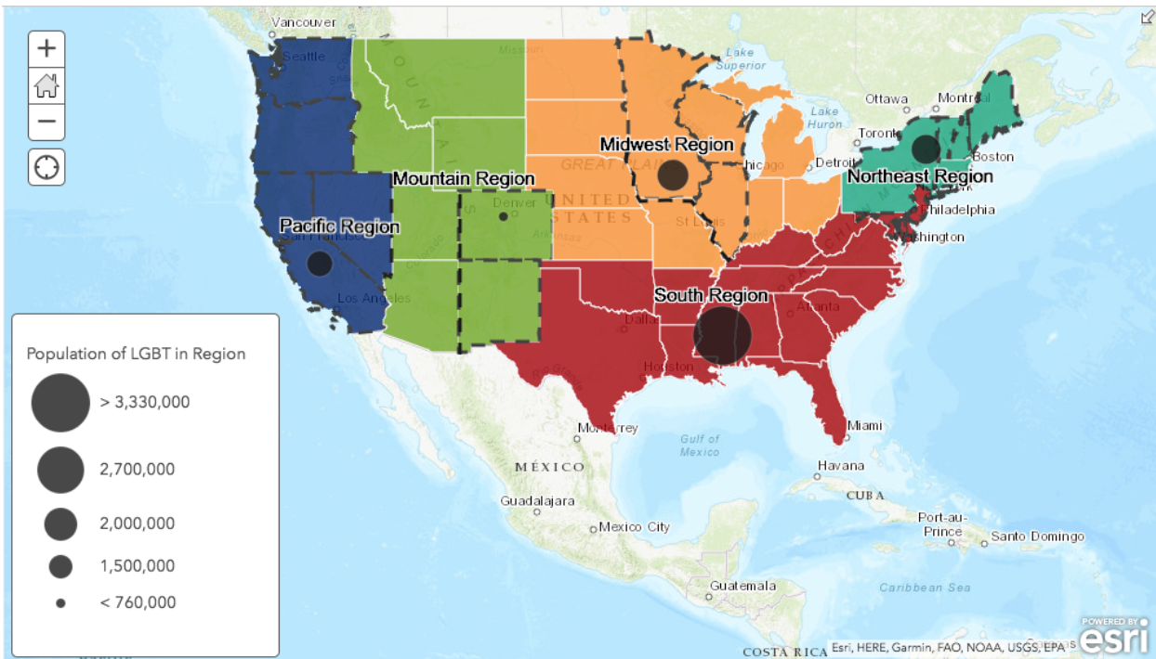
GIS Analyst’s Highlights
*States outlined in black have laws that protect LGBT individuals
*About 8% of the national population identifies as LGBT
*Most of the LGBT population is found in the South region
*About 35% of the adult population consist of LGBT
*In the Mountain region we see the least amount of the LGBT individuals
*Less than 8 percent of the LGBT population
Adoption rates and population

Slide 15
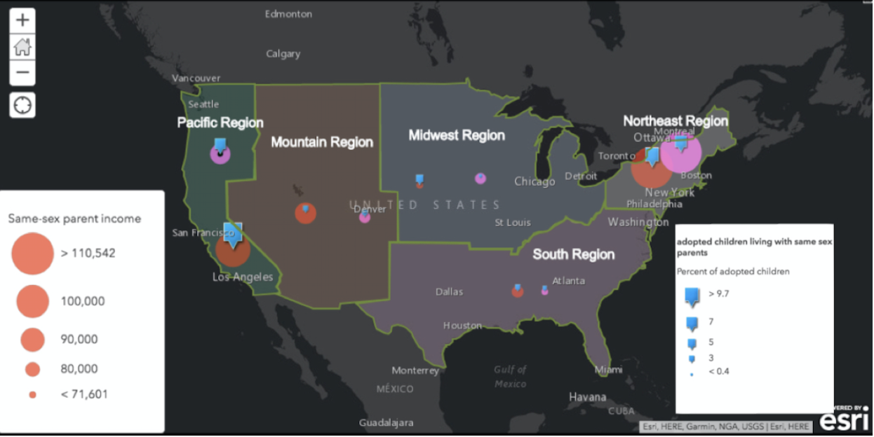
GIS Analyst’s Highlights
Findings:
(1) Same-sex couples in the Mountain states have the lowest adoption rates of same-
(2) Sex couples throughout the country LGBT individuals in the Mountain states are much more likely to report having a household income below $24,000 than their non-LGBT counterparts
(3) Same-sex couples raising children in the South have a household income that is nearly $11,000 lower on average than their different- sex married parent counterparts who are raising children.
Disparity between same-sex parent income and LGBTQ adoption rates across five regions in the Nation
Key: Orange circle: same-sex parent income, Purple circle: opposite-sex parent income, Blue square: adoption rates

Slide 16
Policy Analyst’s Highlights
The federal government needs to work with the state officials to make sure the equal protection clause is not violated
At the state level, legislators need to make sure funding is used to educate the community about LGBT and equal rights.
At the local level communities especially in the South, where most of LGBT individuals live, they need to start conversation on the extended rights these individuals and couples deserve.

Slide 17

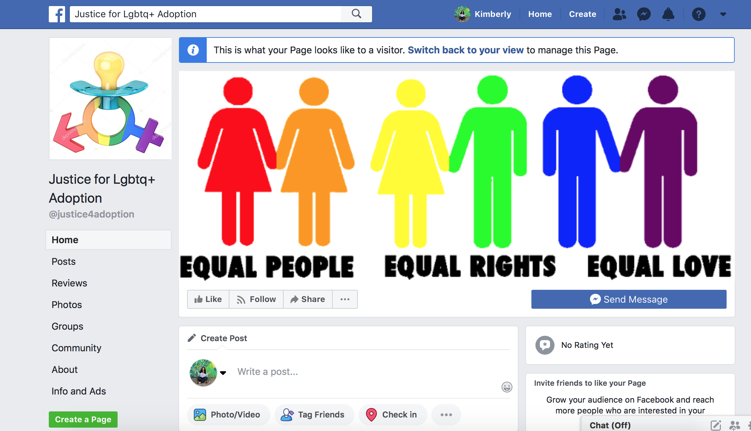
Communications Analyst’s Highlights

Slide 18
Reflection
We have to start small in order to start gaining more awareness about adoption discrimination towards LGBTQ+ parenting.
If we begin with talking about the issue, it will spread attention and awareness for people to start getting involved.
The causes of this issue are linked to the fact that there are currently no policies that protect the adoption rights to LGBTQ+ peoples.
The solutions to the problem include amending the Equal Protection Clause, implementing state laws to meet a quota of adoptions for LGBTQ+ people, and provide public education to our communities to raise awareness.

Slide 19
Bibliography
Gates, Gary, et al. “Adoption Report.” The William Insitute UCLA School of Law, Urban Institute, Mar. 2007.
US Census Bureau. (2018, February 07). Data.
Gates, Gary J., et al. “Adoption and Foster Care by Lesbian and Gay Parents in the United States.” PsycEXTRA Dataset, 12 Jan.
2007.

